Slide 1




Diabetes and cholesterol/heart problems
Name ______________
Supervised by Professor _____________
Course name
Date

Slide 2
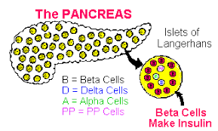
Diabetes mellitus
Diabetes mellitus is a chronic disease with that presents with high blood glucose.
Diabetes is caused by lack of production of adequate insulin, hence poor control of blood glucose.
Diabetes can also be caused by lack of insulin sensitivity by body cells.
These factors hence lead to hyperglycemia characterized by glucose levels of > 12.5g/dl.
Diabetes mellitus has no cure hence the only solution is management. Diabetes affected around 9.4 percent of population in USA in 2019.
Diabetes can lead to various health complications if left uncontrolled.
Notes:
Diabetes is characterized by high blood glucose levels of more than 12.5 g/dl, and HbAiC >6.5%. Diabetes mellitus is a lifestyle condition caused by factors such as poor dietary choices, overweight, inactivity, disease of the pancreas among other factors.

Slide 3

Cholesterol
Cholesterol is a substance made by the liver for the role of protecting nerves, cell tissues and hormones.
Cholesterol is also acquired from food taken including; eggs, dairy and meat products.
There are various types of cholesterol, good cholesterol (HDL) and bad cholesterol ( LDL).
High cholesterol is caused by eating foods high in fats increasing.
Notes:
.

Slide 4
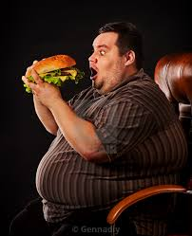
Risk Factors for Diabetes and hypercholesterolemia
Diabetes is caused by a range of factors , including, overweight and obesity, family history.
Hypercholesterolemia is caused by factors that include; inactivity, overindulgence in unhealthy eating behavior, among others.
The causes for Mr.Yate’s condition are majorly lifestyle as indicated in his personal dietary history where he reports to have taken beer and a large stake.
Notes:
Inactivity is related to weight gain which in turn related to increased insulin insensitivity (Pandey et al, 2020 ) . Genetic factors are a risk factor for hypercholesterolemia where some people have a genetic trait for obesity and overproduction of cholesterol. In this case the only intervention would be lifelong administration of drugs to manage the cholesterols.

Slide 5
Mr. Yates’ conditions
Mr. Yates suffers gout as shown by his history of allopurinol intake.
Mr. Yates was diagnosed with diabetes twelve years ago and has been on metformin and later a combination f metformin with insulin.
He suffered myopathy
Other drugs Mr. Yates was taking include; depaglifloxin, ezetimibe, candesartan.
Mr. Yates has recently been on medication for myopathy.
Notes:
Mr. Yates suffers a multitude of conditions which are mostly related to his lifestyle. These conditions require nutritional management and lifestyle changes for better management. Taking some of these drugs concurrently could result to further complications hence review is necessary to avoid harmful counteraction (May & Schindler, 2016). .

Slide 6
Risk factors for Mr. Yates’ conditions
Mr. Yates has a BMI of 32kg/m2 signifying that he is obese, a risk factor for diabetes and hypercholesterolemia.
Presence of uncontrolled sugars is a risk factor for myopathy and retinopathy
Certain medications counteract and led to deterioration.
Poor dietary habits; he reports to have taken beer and a large steak, a practice that is likely to be habitual for him

Slide 7
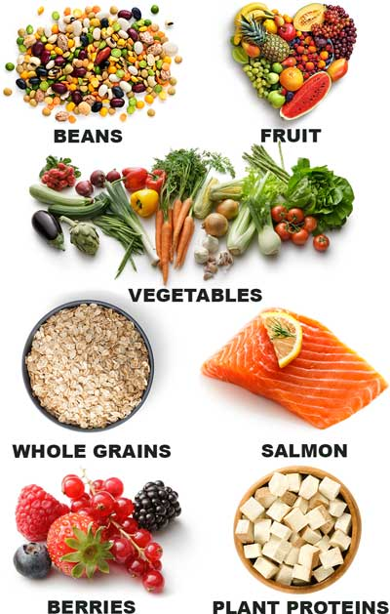
Solutions to Mr. Yates’ conditions
Nutrition education to help him gain knowledge of healthful feeding habits.
Review of his medications to ensure minimal counteraction.
Draft of a specific diet plan for Mr. Yates.
Formulation of an individualized exercise plan to help with weight loss.
Notes:
The conditions Mr. Yates suffers from channel from various factors ranging from, poor dietary choices, overweight and poor management of his sugars . My. Yates also suffers from lack of knowledge on proper practices as seen in his self reported history of beer and a large steaks. These food products are examples of food products with very high cholesterols. Weight management will go a long way in improving Mr. Yate’s condition. Weight loss increases insulin sensitivity in individuals with diabetes mellitus (Pandey et al, 2020).
A specific diet plan over a given period of time would aid in both weight loss and reducing cholesterol intake.

Slide 8

References
May, M., & Schindler, C. (2016). Clinically and pharmacologically relevant interactions of antidiabetic drugs. Therapeutic advances in endocrinology and metabolism, 7(2), 69-83.
Pandey, A., Patel, K. V., Bahnson, J. L., Gaussoin, S. A., Martin, C. K., Balasubramanyam, A., ... & Berry, J. D. (2020). Association of Intensive Lifestyle Intervention, Fitness, and Body Mass Index With Risk of Heart Failure in Overweight or Obese Adults With Type 2 Diabetes Mellitus: An Analysis From the Look AHEAD Trial. Circulation, 141(16), 1295-1306.

Slide 9


